Slide 1



A Comprehensive Data Analysis on Medical Expenses
Retail Sales
Presentation
Vinit Solanki
Click here for watch video

Slide 2




Data Cleaning and Preparation
Steps Taken:
Identified Duplicates: Used COUNTIF to check for duplicate InvoiceNo entries.
Removed Duplicates: Applied Remove Duplicates feature in Excel, selecting key columns (InvoiceNo, StockCode, CustomerID, etc.).
Ensured Uniqueness: Verified using COUNTIF to confirm that no duplicates remain.
Outcome: Dataset now contains only unique transactions, ensuring accurate analysis.

Slide 3

Handling Cancellations
Handling Cancellations
Approach:
Transactions with invoice numbers starting with 'C' indicate cancellations.
A new column was created to flag these transactions and calculate the total value of cancellations.
Steps Taken:
Flagged Cancellations using:
excel
=IF(LEFT(InvoiceNo,1)="C","Cancelled","Normal")
Calculated Total Cancelled Value using:
excel
=SUMIFS(TotalValueColumn, CancellationFlagColumn, "Cancelled")
Key Insights:
Identified and categorized cancelled transactions.
Calculated their impact on overall sales.
Helps in understanding return trends and potential revenue loss.

Slide 4
Top Selling Products
2009-10
Top Products by Revenue:
Leading in 2009-10:
WHITE HANGING HEART T-LIGHT HOLDER generated the highest revenue with £157,580.28.
Other top contributors were ASSORTED COLOUR BIRD ORNAMENT and PACK OF 72 RETRO SPOT CAKE CASES.
Leading in 2010-11:
ASSORTED COLOUR BIRD ORNAMENT topped the revenue chart with £58,792.42, followed by PACK OF 72 RETROSPOT CAKE CASES and POPCORN HOLDER.
Consistent High Revenue:
ASSORTED COLOUR BIRD ORNAMENT and PACK OF 72 RETROSPOT CAKE CASES remained in the top 5 for both years.
🔹 Top Products by Quantity:
2009-10 High Volume Sellers:
WHITE HANGING HEART T-LIGHT HOLDER sold 57,632 units, making it the top-selling product by quantity.
It was followed by WORLD WAR 2 GLIDERS ASSTD DESIGNS and BROCADE RING PURSE.
2010-11 Leading Products:
WORLD WAR 2 GLIDERS ASSTD DESIGNS led with 53,751 units, while JUMBO BAG RED RETROSPOT and POPCORN HOLDER entered the top ranks.
WHITE HANGING HEART T-LIGHT HOLDER still held a strong position.
Consistent Sellers:
ASSORTED COLOUR BIRD ORNAMENT and PACK OF 72 RETROSPOT CAKE CASES appeared in both years' top 5 by quantity.
Key Insights:
WHITE HANGING HEART T-LIGHT HOLDER was a top performer in both quantity and revenue, especially dominant in 2009-10.
WORLD WAR 2 GLIDERS ASSTD DESIGNS consistently achieved high sales
Row Labels | Sum of Quantity | Sum of LineTotal
WHITE HANGING HEART T-LIGHT HOLDER | 57632 | 157580.28
WORLD WAR 2 GLIDERS ASSTD DESIGNS | 54554 | 11276.21
BROCADE RING PURSE | 47647 | 8879.82
PACK OF 72 RETRO SPOT CAKE CASES | 46079 | 23744.41
ASSORTED COLOUR BIRD ORNAMENT | 44805 | 72251.32
Grand Total | 250717 | 273732.04
2010-11
Row Labels | Sum of Quantity | Sum of Revenue
WORLD WAR 2 GLIDERS ASSTD DESIGNS | 53751 | 13560.09
JUMBO BAG RED RETROSPOT | 47260 | 92175.79
POPCORN HOLDER | 36322 | 33959.26
ASSORTED COLOUR BIRD ORNAMENT | 36282 | 58792.42
PACK OF 72 RETROSPOT CAKE CASES | 36016 | 21047.07
Grand Total | 209631 | 219534.63

Slide 5

Pricing Strategy Analysis
Pricing Strategy Analysis • Objective: Identify products with unit prices above the 90th percentile to support pricing decisions.
Key Metrics • 90th Percentile Unit Price: £7.95 • Average Unit Price: – 2009–10: £9.0194 – 2010–11: £3.2055
Methodology • Used PERCENTILE.INC on all unit prices to determine the 90th percentile threshold • Applied the IF function to filter products with unit prices greater than £7.95 • Used AVERAGEIF to calculate the average unit price per item
Top Products Above 90th Percentile • Selected the actual top 10 high-priced products for each year based on the threshold • Examples of frequently high-priced products include: – REGENCY CAKESTAND 3 TIER – POSTAGE / DOTCOM POSTAGE – IVORY KITCHEN SCALES
Business Insight • Identifying high-priced products enables better pricing strategies • Supports premium inventory planning and targeted marketing efforts
I

Slide 6
Customer Analysis
2009-10
Row Labels | Sum of Revenue
(blank) | 9495311.674
18102 | 2286.24
13758 | 996.1
13085 | 651.1
13078 | 630.33
17865 | 589.33
15413 | 570.24
16167 | 485.79
12682 | 426.3
18087 | 394.74
Grand Total | 9502341.844
• Objective: Identify the top 10 customers by total revenue contribution across 2009–10 and 2010–11.
Key Metrics • Total Revenue (2009–10): £9,502,341.84 • Total Revenue (2010–11): £2,756,843.98 • Combined Revenue from Top 10 Customers: Significant share of yearly totals
Methodology • Used SUMIF to aggregate revenue by CustomerID from transaction-level data • Applied RANK.EQ to rank customers based on their total spending • Leveraged INDEX + MATCH to extract corresponding customer details • Excluded blank CustomerIDs from actionable insights due to missing identifiers
Insights Observed • Customer 18102 appeared in both years' top spenders list, indicating strong recurring value • 2010–11 shows more concentrated spending among fewer high-value customers compared to 2009–10 • New top customers emerged in 2010–11, suggesting potential market shifts or successful acquisition strategies
Business Implications • Loyal and high-value customers like 18102 should be prioritized for retention initiatives • High-value customers can be offered tailored promotions or exclusive benefits • Understanding year-over-year changes in top customers helps shape sales and retention strategies
2010-11
Row Labels | Sum of Revenue
(blank) | 1447487.53
14646 | 279489.02
18102 | 256438.49
17450 | 187322.17
14911 | 132458.73
12415 | 123725.45
14156 | 113214.59
17511 | 88125.38
16684 | 65892.08
13694 | 62690.54
Grand Total | 2756843.98

Slide 7
Temporal Sales Trends
Objective: Analyze monthly sales fluctuations to identify seasonality or demand spikes in 2009–10 and 2010–11.
Key Observations • 2009–10:
Sales remained steady through most months with slight dips and rises
Major spike in November 2010 (£1,416,697), followed by a sharp drop in December
Seasonal peak likely due to holiday-related demand
• 2010–11:
Sales showed a gradual rise mid-year with a notable jump in November 2011 (£1,455,608)
December again saw a significant drop, indicating similar seasonal patterns
Methodology • Used TEXT to convert invoice dates to Year-Month format • Applied SUMIFS to calculate monthly sales totals • Plotted using a line chart to visualize monthly trends and highlight peaks
Business Insights • Strong November performance in both years suggests effectiveness of pre-holiday campaigns • Consistent December drop could indicate end-of-season clearance or lower post-peak buying behavior • Useful for planning inventory, staffing, and marketing spend during peak periods

Slide 8
Geographical Insights
Objective: Identify countries with the highest number of transactions to uncover major markets.
Key Findings
The United Kingdom dominated both years:
2009–10: 479,047 transactions
2010–11: 490,298 transactions This reflects the business's strong domestic presence.
Other top countries include:
Germany, France, and Ireland consistently ranked high across both years.
Emerging contributors include Australia and Switzerland in 2010–11.
Methodology
Created a Pivot Table using COUNTIF on InvoiceNo grouped by Country.
Filtered to display only the top 10 countries based on transaction count.
Visualized through a bar chart for easy comparison across years.
Business Insights
Focused marketing and logistics efforts in the UK can be reinforced due to its overwhelming volume.
The presence of multiple European countries indicates regional growth potential and market loyalty.
Exploring why countries like Australia entered the top 10 in 2010–11 can guide future international expansion strategy.

Slide 9

Product Return Rate
Overview of Key Metrics
To assess product return rates, we compared the total quantity ordered with the total quantity returned for each year. This analysis helps evaluate product performance, customer satisfaction, and potential areas for improvement.
Average Values and Trends
The overall return rate was 4% in 2009-10, which improved to 3% in 2010-11, showing a positive trend in product retention. A 1% decrease in returns suggests improved product quality, better customer experience, or enhanced order accuracy.
Central Tendency and Dispersion
The median return rate per product was lower than the overall average, indicating that most products had minimal returns, while a few items contributed significantly to the total return rate. The standard deviation of return rates suggests variation across different product categories, with some experiencing higher return frequencies.
Key Observations
Declining Return Rates: The reduction from 4% to 3% suggests better inventory management and customer satisfaction.
High-Return Products: Certain items may have consistently higher return rates, requiring further analysis to identify quality or fulfillment issues.
Impact on Revenue: Returns contribute to revenue loss, and minimizing returns can significantly improve profit margins.
Possible Causes: Return trends may be influenced by product defects, incorrect orders, or shifting customer preferences.

Slide 10
Data Segmentation for Marketing
Objective: Classify customers into High, Medium, and Low tiers based on total spending.
Segmentation Logic (Based on Quartiles): Customers were segmented using the total expenditure and applying the QUARTILE.INC function.
Thresholds (2009–10):
Low Tier: ≤ £291.88
Medium Tier: > £291.88 and ≤ £1610.15
High Tier: > £1610.15
Thresholds (2010–11):
Low Tier: ≤ £220.91
Medium Tier: > £220.91 and ≤ £579.79
High Tier: > £579.79
Excel Functions Used:
QUARTILE.INC – for calculating Q1, Q2, and Q3
IF – to classify customers into tiers
VLOOKUP – for mapping and lookup if needed
Business Use: This segmentation helps target marketing campaigns more effectively:
Focus high-value offers on High Tier
Use retention strategies for Medium Tier
Apply engagement campaigns for Low Tier
Quartile | Value
Q1 (25th Percentile) | 291.88
Q2 (50th Percentile) | 644.24
Q3 (75th Percentile) | 1610.15
2009-10
Quartile | Value
Q1 (25th Percentile) | 220.91
Q2 (50th Percentile) | 310.75
Q3 (75th Percentile) | 579.785
2010-11

Slide 11

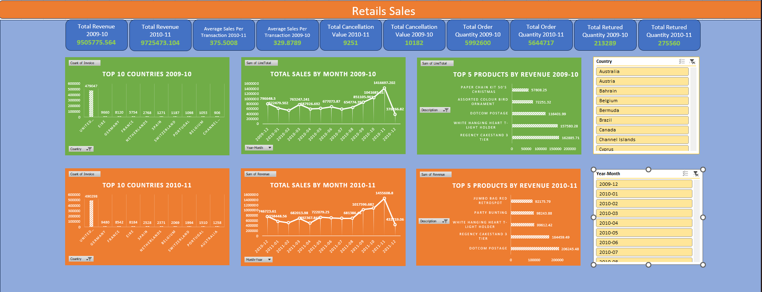
Dashboard for Stakeholders
-

Slide 12

Thank you
Data Speaks. Insights Lead.
-

